Slide 1

Project 150 Final submission
Name : Ahmed Yunus
Registration no : 2014331036
Submitted to : Summit Haque,
Lecturer, CSE, SUST
Submission Date : 10/01/2019

Slide 2
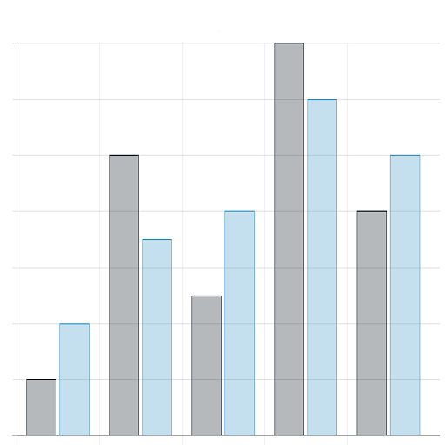
GraphS
A simple graph simulation software

Slide 3
What is an GraphS
GraphS is a graph simulation software written in Python. It can take various kind of inputs and simulate them in different kind of graphs.
Graphs it can plot: Python Library used in GraphS:
1.Linear Line 1. Tkinter
2.Bar diagram 2.Matplotlib
3.Pie Diagram 3.Numpy

Slide 4
What GraphS can do
It takes 3 kind of inputs :
Direct Input : Inputs data point directly and draw it.
Database Input : Inputs data from a database and draw it
Excel/CSV file input : Inputs data from a file and draw it .

Slide 5
Direct Input
It has 3 kind of options :
Point input : Directly takes x and y and plot them
Statistical input [Point]: Takes x values and find frequencies, analysis and plot them
Statistical input [Range]: Takes x value as any name and Y value as percentage and then plot them.

Slide 6
Database Input
Database input analysis data from a database.:
Column vs Column
Column vs frequency of tuple of an column .
Column vs average of tuple of an column .

Slide 7
Excel/CSV file Input
File input analysis data from a file:
Column vs Column
Column vs frequency of tuple of an column .
Column vs average of tuple of an column .

Slide 8

WHY GRAPHS ? A PICTURE IS WORTH A THOUSAND WORDS
A complex graph simulation system can map the overall interactivity between differenct dimensions of data.

Slide 9

Thanks to
All.
-----------------------------
The END

